Slide 1
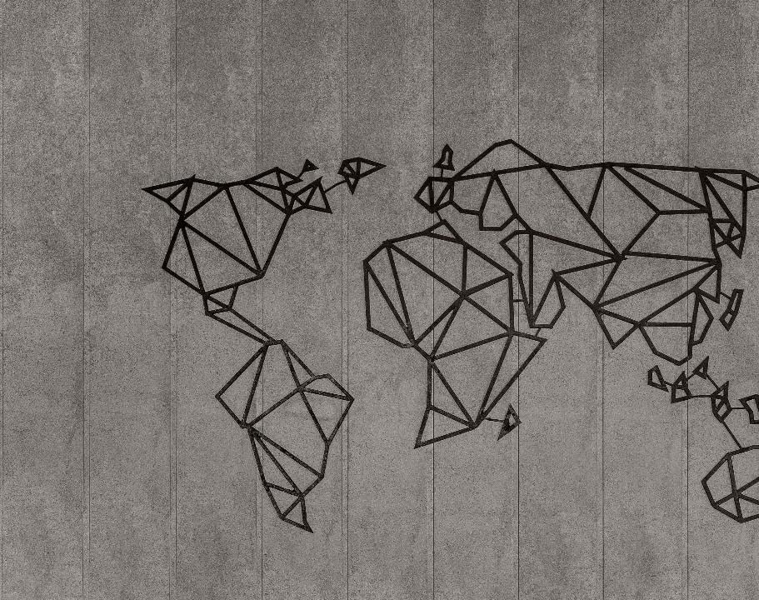
Map Gen Class Library
Descriptions of the “MapGen” class of functions

Slide 2
The MapGen class library hosts tools to build maps useful for studying path planning, autonomy, etc.
The result of these operations is some data representation of the expected environment.

Slide 3
Definitions of terms are important so that we don’t get confused later
Polytope
Polytopes

Slide 4
For many examples below, MATLAB code will be given. It is usually highlighted as shown here: yellow for scripts, grey for console outputs.
%% Example 1: simple three points
fig_num = 1;
x = [-4; -2; 1];
y = [0; -4; -1];
apex_points = [x y];
fcn_FastestTraversal_calculateObstacleDirectionAtApexPoints(...
apex_points, fig_num);
>> script_test_fcn_geometry_selfCrossProduct
cross_products =
0
err =
1

Slide 5
Each function uses a class-specific argument check function
function fcn_MapGen_checkInputsToFunctions(...
variable,variable_type_string,varargin)
% fcn_MapGen_checkInputsToFunctions
% Checks the variable types commonly used in the MapGen codes to
% ensure they are correctly formed.
%
% This function is typically called at the top of most functions. The input
% is a variable and a string defining the "type" of the variable. This
% function checks to see that they are compatible. For example, say there
% 'column_vector' type of variables used in the function that is always a N
% x 1 array; if someone had a variable called "test_example", they could
% check that this fit the 'column_vector' type by calling
% fcn_MapGen_checkInputsToFunctions(test_example,'column_vector').
% This function would then check that the array was N x 1, and if it was
% not, it would send out an error warning.
%
% FORMAT:
%
% fcn_MapGen_checkInputsToFunctions(...
% variable,variable_type_string,(optional_arguments))
%
% INPUTS:
%
% variable: the variable to check
See: script_test_fcn_MapGen_checkInputsToFunctions.m for example usages

Slide 6
A demonstration script exists that shows most of the functionality in this document: script_demo_MapGenLibrary
%% Show how inputs are checked
Twocolumn_of_numbers_test = [4 1; 3 0; 2 5];
fcn_MapGen_checkInputsToFunctions(Twocolumn_of_numbers_test, '2column_of_numbers');
%% Generate a set of polytopes from various pseudo-random sources
% Generate a set of polytopes from the Sobol set
fig_num = 11;
Sobol_range = [1 1000]; % range of Sobol points to use to generate the tiling
tiled_polytopes = fcn_MapGen_sobolVoronoiTiling(Sobol_range,[1 1],fig_num);
% Generate a set of polytopes from the Halton set
fig_num = 12;
Halton_range = [1 1000]; % range of Halton points to use to generate the tiling
tiled_polytopes = fcn_MapGen_haltonVoronoiTiling(Halton_range,[1 1],fig_num);

Slide 7
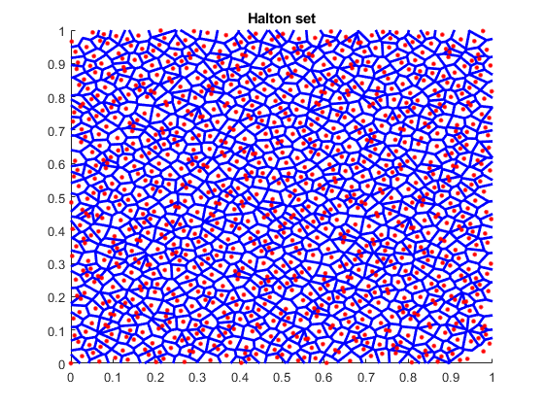
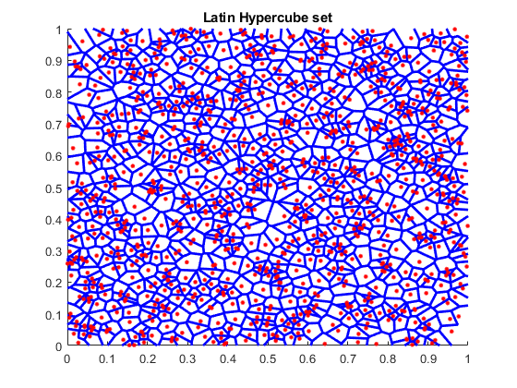
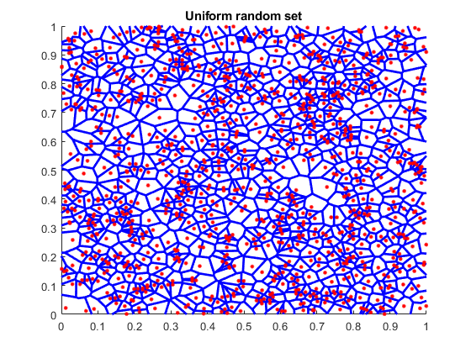
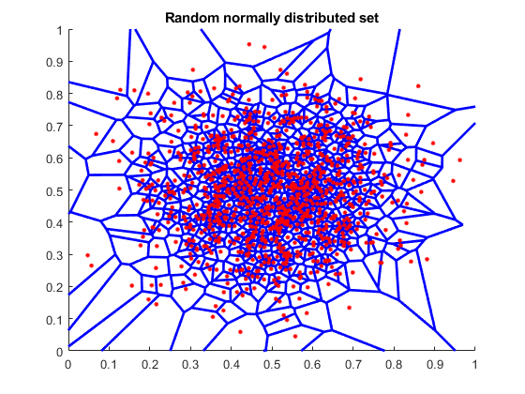
There are a number of pseudo-random number generators that can be used to create tilings within a map, and the results of each are very different.

Slide 8
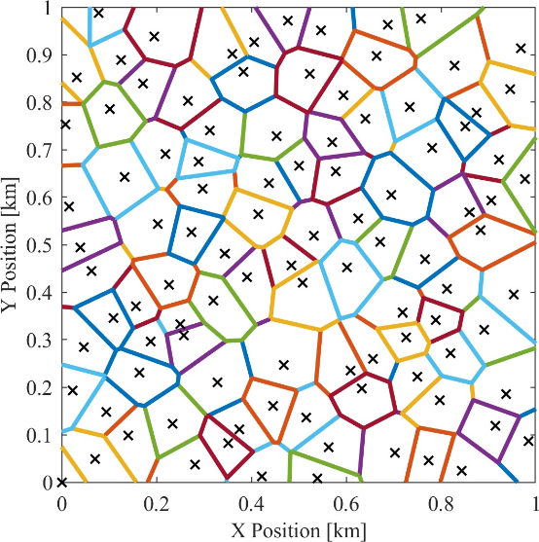
The Halton set is the one we use most often and in nearly all the codes
It gives fairly uniform, non-repeating tilings without clumping

Slide 9
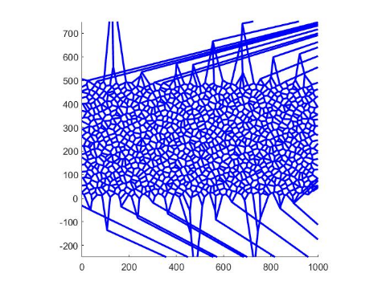
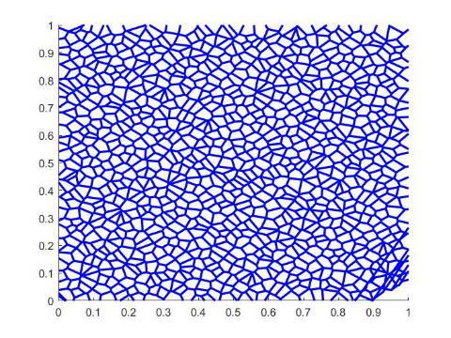
The sets are generated by selecting random numbers in 2 dimensions between 0 and 1, then performing a Voronoi segmentation based on the seed points
The images shown are cropped views, so the outlier boundaries are not seen

Slide 10
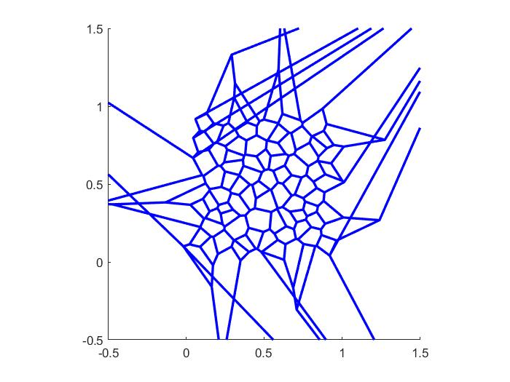
When generating polytopes, the number of results is equal to or less than (usually slightly) than the number of seed points
Some polytopes along edges extend out of the region and are deleted, resulting in fewer polytopes than seeds

Slide 11
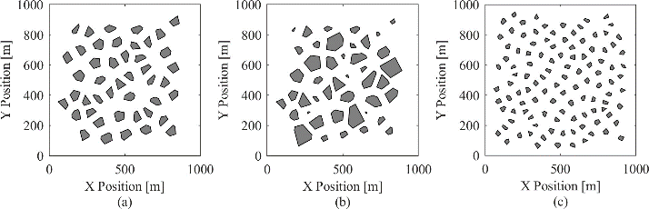
There are defining properties of each map with respect to obstacles
The maps generated in this function are constrained by three main factors:
point density,
average obstacle radius, and
standard deviation in obstacle radius.
The image below shows three maps with variations in these three parameters
Maps (a) and (b) have point densities of 75 points per square kilometer, and map (c) has a point density of 150 points per square kilometer. Maps (a) and (b) have average obstacle radii of 50 meters, and map (c) has an average obstacle radius of 30 meters. Maps (a) and (c) have standard deviations in obstacle radius of 0, and map (b) has a standard deviation in obstacle radius of 20 meters.

Slide 12
The point density is defined as the number of obstacles (or points) per unit area
This describes how close the obstacles are to one another.

Slide 13
Obstacle radius is defined as the distance from an obstacle's centroid to its furthest vertex.
The average obstacle radius is the average of all obstacles being considered.

Slide 14
The standard deviation in obstacle radius is the standard deviation of those obstacle radius values.

Slide 15
The process of generating tiled obstacle polytopes uses 3 steps: initial tiling, trimming edges, and then shrinking the poloytopes down
%% Show how the maps can be trimmed, shrunk, etc
% Generate a set of polytopes from the Halton set
fig_num = 21;
Halton_range = [1 200]; % range of Halton points to use to generate the tiling
tiled_polytopes = fcn_MapGen_haltonVoronoiTiling(Halton_range,[1 1],fig_num);
% Plot the polytopes
fig_num = 22;
line_width = 2;
axis_limits = [0 1 0 1];
fcn_MapGen_plotPolytopes(tiled_polytopes,fig_num,'r',line_width,axis_limits);
% remove the edge polytopes that extend past the high and low points
fig_num = 23;
xlow = 0; xhigh = 1; ylow = 0; yhigh = 1;
bounding_box = [xlow ylow; xhigh yhigh];
trimmed_polytopes = ...
fcn_MapGen_polytopeCropEdges(tiled_polytopes,bounding_box,fig_num);
% Shrink to radius
fig_num = 24;
des_rad = 0.03; sigma_radius = 0; min_rad = 0.001;
shrunk_polytopes2=fcn_MapGen_polytopesShrinkToRadius(...
trimmed_polytopes,des_rad,sigma_radius,min_rad,fig_num);
See script_demo_MapGenLibrary.m

Slide 16
Individual polytopes are shrunk with fcn_MapGen_polytopeShrinkToRadius by moving all verticies towards the centroid by some scalar multiplier, derived from the desired final max radius. Max radius is the distance from the centroid to the furthest vertex.
% determine scale factor
scale = new_radius/rad;
…
% find new vertices
new_vert = centroid + scale*(vertices-centroid);

Slide 17
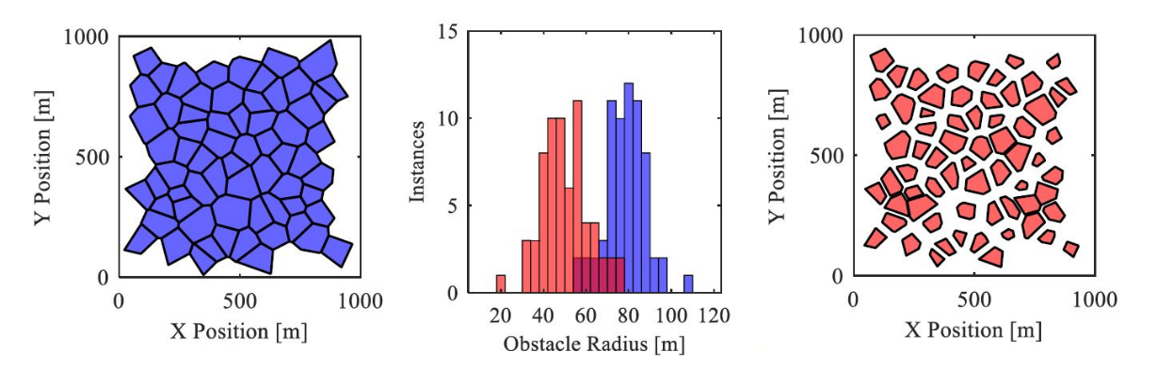
The shrinking process allows introduction of random choice in which polytopes are shrunk, which allows user to set desired mean and standard deviations
See script_demo_MapGenLibrary.m

Slide 18
This is achieved in fcn_MapGen_polytopesShrinkToRadius by first creating a normally distributed set of radii with the desired mean and standard deviation. Then, using a user-defined minimum radius as the minimum value and the current max radius of the polytope as a maximum value, values in the distribution falling out of bounds are reset to the max or min as appropriate.
% determine desired distribution
new_r_dist = normrnd(des_radius,sigma_radius,[Nradii,1]);
…
new_r_dist(new_r_dist>max_r_dist) = max_r_dist(new_r_dist>max_r_dist); % truncate any values that are too large
new_r_dist(new_r_dist<min_r_dist) = min_r_dist; % truncate any values that are too small

Slide 19
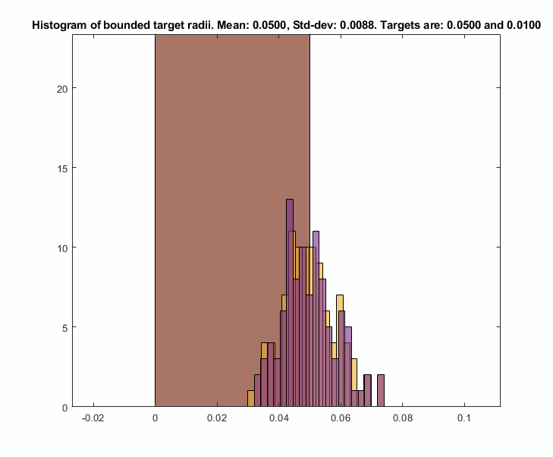
As this truncating operation may shift the mean, the values of the distribution are shifted by the delta between the current mean and the desired mean until the desired mean is reached.
while abs(mean(new_r_dist) - des_radius) > 1e-10
new_r_dist = new_r_dist + (des_radius-mean(new_r_dist));
...
end

Slide 20
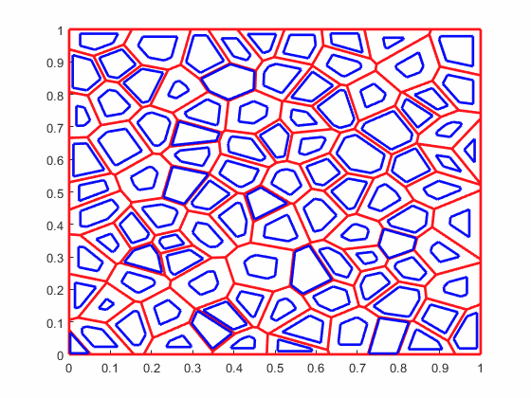
Radii changes and current polytopes are then sorted by size so the largest changes can be applied to the largest polytopes, ensuring all polytopes have enough area to be scaled down. Polytopes are then looped through and scaled with the previously described function fcn_MapGen_polytopeShrinkToRadius
[new_radii_sorted,ob_index] = sort(new_r_dist);
% Check that the old polytopes are large enough to shrink and
% achieve the new radius distribution. Want all the changes to be smaller
% than -2 times the minimum radius, to ensure we do not get singular % I
% have no idea why we do this
% polytopes.
change_in_radii = sort(old_max_radii)'-sort(new_r_dist);
Num_goal_polys_smaller_than_start = sum(change_in_radii>=-2*min_rad);
if Num_goal_polys_smaller_than_start < Nradii
error('distribution is unachievable with generated map')
end
% Initialize the shrunk polytopes structure array, and tolerance for
% distance between vertices, below which vertices are merged into one.
shrunk_polytopes = polytopes;
tolerance = 1e-5; % Units are (implied) kilometers
% Loop through each polytope, shrinking it to the reference size
for ith_radii = 1:length(new_radii_sorted)
shrinker = polytopes(ob_index(ith_radii)); % obstacle to be shrunk
des_rad = new_radii_sorted(ith_radii);
% assign to shrunk_polytopes
shrunk_polytopes(ob_index(ith_radii)) = ...
fcn_MapGen_polytopeShrinkToRadius(...
shrinker,des_rad,tolerance);
end

Slide 21
Shrink from Edges Functionality
Updated 2022-02-17 by S. Brennan

Slide 22
Individual polytopes can be shrunk by edges, and the first step is to find the Vertex Skeleton via: fcn_MapGen_polytopeFindVertexSkeleton This function defines how the vertices “move” as edges are trimmed inward by the same amount.
fig_num = 675;
vertices = [0 0; 2 0; 1 2; 0 1; 0 0]*5;
fcn_MapGen_polytopeFindVertexSkeleton(vertices,fig_num);

Slide 23
The skeleton is calculated by iterating inward from the given vertices
As long as there are more than 2 vertices, it:
Calculates the vectors pointing inward, and angles they make relative to next segment (“half angles”)
Using the angles and vectors, calculates where the vectors intersect
Finds the minimum distance of intersection
Merges vertices that come together
Repeats

Slide 24
Step 1: To calculate the vectors inward, the function calls an internal function to obtain unit vectors inward, the half angles, the distances from vertex-to-vertex, and unit vectors from vertex to vertex.
[vector_direction_of_unit_cut, ...
half_angles,...
distances_vertex_to_vertex,...
unit_vectors_vertex_to_vertex] = ...
INTERNAL_fcn_findUnitDirectionVectors(working_vertices,333);

Slide 25

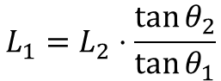
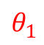
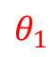
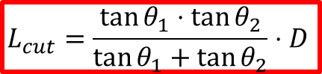
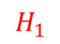
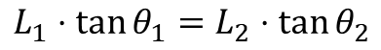
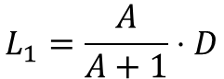
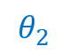
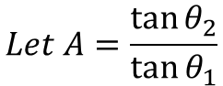
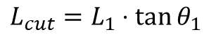
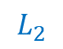
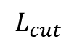
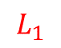
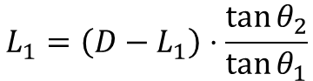
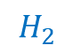

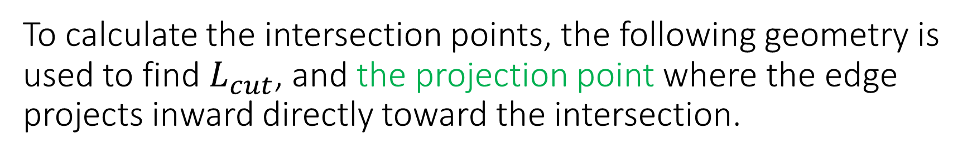

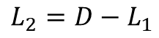
To calculate the intersection points, the following geometry is used to find $L_{cut}$, and the projection point where the edge projects inward directly toward the intersection.
$$L_{1}⋅\tan{θ_{1}}=L_{2}⋅\tan{θ_{2}}$$
$$L_{1}=L_{2}⋅\frac{\tan{θ_{2}}}{\tan{θ_{1}}}$$
$$L_{2}=D−L_{1}$$
$$θ_{1}$$
$$H_{1}$$
$$L_{1}=\left(D−L_{1}\right)⋅\frac{\tan{θ_{2}}}{\tan{θ_{1}}}$$
$$1$$
$$θ_{1}$$
$$L_{cut}$$
$$L_{1}$$
$$Let A=\frac{\tan{θ_{2}}}{\tan{θ_{1}}}$$
$$H_{2}$$
$$L_{1}=\frac{A}{A+1}⋅D$$
$$L_{cut}=L_{1}⋅\tan{θ_{1}}⁡$$
D
$$L_{2}$$
$$θ_{2}$$
$$θ_{2}$$
$$L_{cut}=\frac{\tan{θ_{1}}⋅\tan{θ_{2}}}{\tan{θ_{1}}+\tan{θ_{2}}}⋅D⁡$$
$$2$$

Slide 26
Using the half-angles to define the theta1 and theta2 values, one can find the projection points from each edge
These projection points are where the orthogonal from each edge would intersect the vertices, as vertices shrink inward and touch each other.

Slide 27
We next rotate the unit vectors from one corner to another by 90 degrees, and starting from the projection points, move inward by Lcut. This predicts the intersection points of the vertices.

Slide 28
The minimum cut distance defines how far we can cut inward before vertices merge. The indices that merge have to have the same cut distance and follow one after the other.
Once we know which vertex is the closest, we need to move all vertices inward by ONLY the shortest cut distance.

Slide 29
Before starting on the next step, in case there are only 2 points left, we calculate the vector direction of the unit cuts for the new vertices just created.
These are just the average of the adjacent vectors that were merged. This is repeated until all the points converge, or only 2 points are left

Slide 30
The final result is the skeleton plot
The outputs give:
new_vertices: a cell array of dimension M, where each index 1:M stores a N x 2 array of the coordinates of the nested shape inside, with M = 1 being the starting shape (and with dimension K+1, where K is number of vertices given), and N being smaller and smaller for each M value.
new_projection_vectors: a cell array of M, where each index 1:M stores a L x 2 array of the unit vectors (with L = N-1) that point away from the vertices of the nested shape inside, with M = 1 being the starting unit vectors (and with dimension K, where K is number of vertices given), and L being smaller and smaller for each M value.
cut_distance: a cell array of M, ranging from 0 (for M=1) to the maximum cut distance that can be used

Slide 31
To use this, we index the template corresponding to our cut depth, and cut more if needed
fig_num = 675;
vertices = [0 0; 2 0; 1 2; 0 1; 0 0]*5;
[new_vertices, new_projection_vectors, cut_distance] = fcn_MapGen_polytopeFindVertexSkeleton(vertices,fig_num);
figure(4747);
grid on
grid minor
hold on
axis equal
for cut = 0:0.5:cut_distance(end)
% Find the shape that is less than or equal to the cut
shape_index = find(cut_distance<=cut,1,'last');
% Grab vertices to start from, cut to start from
starting_vertices = new_vertices{shape_index};
starting_cut = cut_distance(shape_index);
% Calculate projection distance
projection_distance = cut - starting_cut;
% Determine final vertices
final_vertices = starting_vertices + new_projection_vectors{shape_index}*projection_distance;
% Plot results
plot(final_vertices(:,1),final_vertices(:,2),'r.-','Linewidth',2,'Markersize',20);
end

Slide 32
Here’s other examples:
Goofy Polytope:
Square:
Wide Rectangle:
Tall Rectangle:
Random Polytope:
See: script_test_fcn_MapGen_polytopeFindVertexSkeleton
For more examples

Slide 33
The function fcn_MapGen_polytopeShrinkFromEdges implements the skeleton calculations to perform the shrinkage
This is implemented in three steps:
1. Calculate the polytope skeleton, or use the skeleton if the user
provides this as inputs.
2. Using the cut distance, find the template that is less than or equal
to the cut distance. If less, then calculate the additional cut and
project the verticies to their new points based on residual cut.
3. Convert the resulting verticies into the standard polytope form.

Slide 34
The code that performs the cutting is relatively simple. It uses the largest template that corresponds to a cut smaller or equal to the requested cut.
%% STEP 2. Using the cut distance, find the template
% We want to use the one that is less than or equal to the cut distance. If
% less, then calculate the additional cut and project the verticies to
% their new points based on residual cut.
% Find the shape that is less than or equal to the cut
shape_index = find(cut_distance<=edge_cut,1,'last');
% Grab vertices to start from, cut to start from
template_vertices = new_vertices{shape_index};
template_start_cut = cut_distance(shape_index);
% Calculate projection distance
additional_cut_distance = edge_cut - template_start_cut;
% Determine final vertices
final_vertices = template_vertices + new_projection_vectors{shape_index}*additional_cut_distance;

Slide 35
The results are as expected
Square:
Right Triangle:
Right Triangle Cut too Deeply
Repeated cuts:
See: script_test_fcn_MapGen_polytopeFindVertexSkeleton
For more examples

Slide 36
When using edge cutting, particularly if repeatedly using this, significant computation time is saved if one avoids repeated calculation of the skeleton.
If one precomputes, this and reuses it, it can save roughly 10 times the computation. If one avoids polytope calculations and just needs the vertices, it saves roughly 100 times the calculations

Slide 37
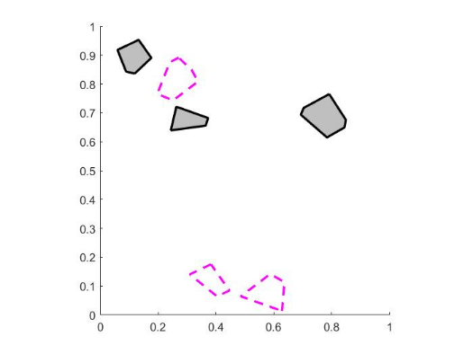
Several functions exist to plot maps. The one for polytopes is: fcn_MapGen_plotPolytopes
% Plot the polytopes
fig_num = 22;
line_width = 2;
axis_limits = [0 1 0 1];
fcn_MapGen_plotPolytopes(tiled_polytopes,fig_num,'r',line_width,axis_limits);

Slide 38
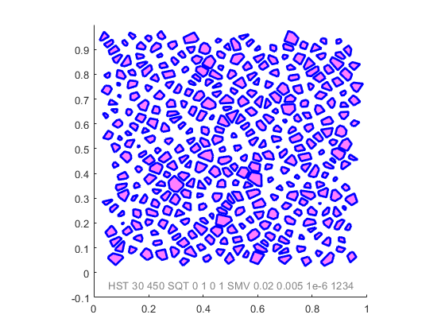
We often want to generate maps by a fully repeatable “name”
The idea is that a string can be produced, and even plotted on the figure, that when entered into the function generates EXACTLY the same map again. This is exceptionally useful for debugging.
%% Generate a map from a name
map_name = "HST 30 450 SQT 0 1 0 1 SMV 0.02 0.005 1e-6 1234";
plot_flag = 1; disp_name = [1, 0.05 -0.05, 0.5 0.5 0.5, 10];
line_style = '-'; line_width = 2; color = [0 0 1];
axis_limits = [0 1 -0.1 1]; axis_style = 'square';
fill_info = [1 1 0 1 0.5];
fig_num = 7;
[polytopes,fig]=fcn_MapGen_nameToMap(...
map_name,...
plot_flag,...
disp_name,...
fig_num,...
line_style,...
line_width,....
color,...
axis_limits,...
axis_style,...
fill_info);

Slide 39
Various methods for estimating area unoccupancy ratio are in the function fcn_MapGen_polytopesPredictUnoccupancyratio

Slide 40
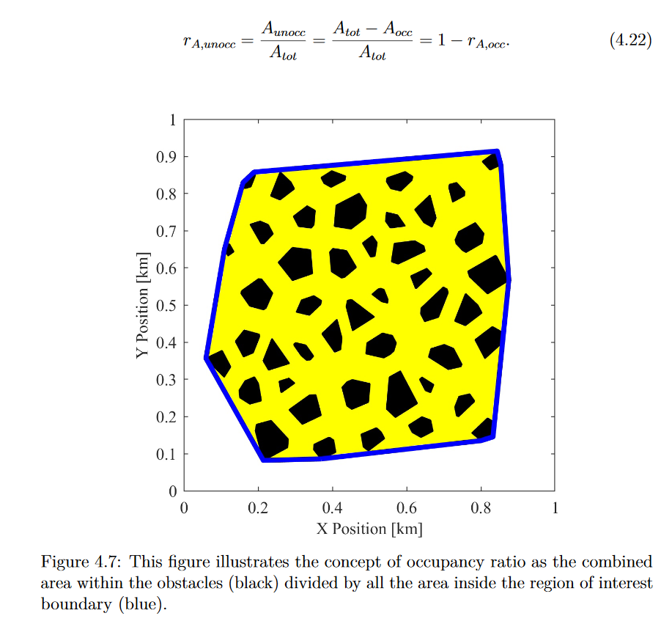
Area occupancy can be measured directly from area. This is stored in A_unocc_meas. See the following from Seth Tau’s PhD Thesis, “THE EFFECTS OF PATH-PLANNING UNCERTAINTY ONINTELLIGENT VEHICLE PERFORMANCE”:

Slide 41
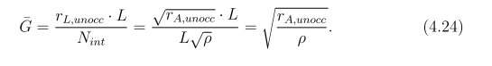
The most basic estimate can be found from dimensionless analysis (see formula 4.24 in Seth Tau’s thesis). This is stored in A_unocc_est_density.

Slide 42
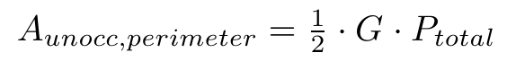
The perimeter estimation method associates all unoccupied area with side length perimeters so does not account for the area at vertices. Also breaks when edges are removed. This estimate is stored in A_unocc_est_perim.

Slide 43
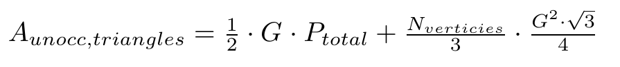
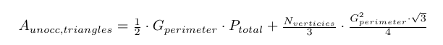
This can be modified to include an equilateral triangle with a side length equal to gap size as a crude estimate for including this unaccounted for space. This is stored in A_unocc_est_perim_imporoved.

Slide 44
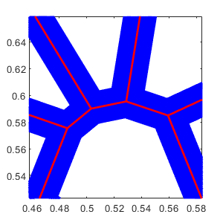
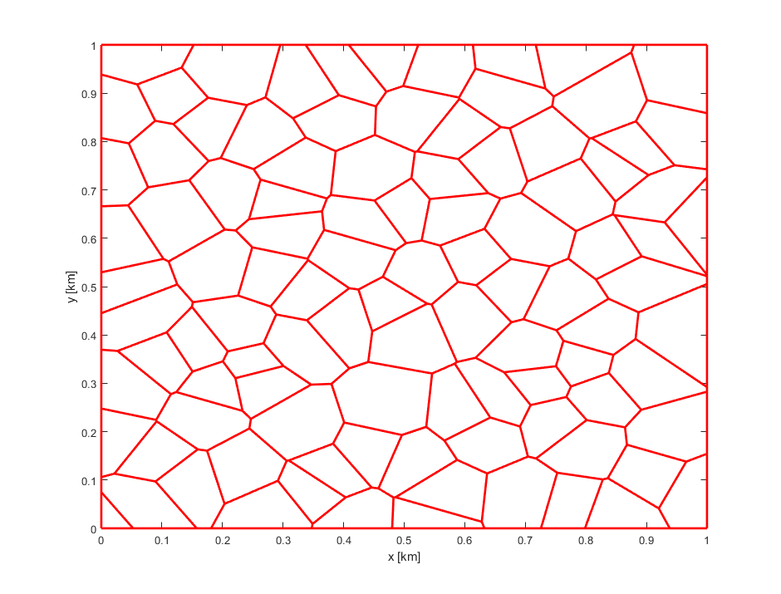
Triangles are not a bad approximate for small gaps because all Voronoi diagram intersections are 3-way intersections. Complex intersections in the Voronoi diagram can be decomposed into 3-way intersections.

Slide 45
Triangles are not a bad approximate for small gaps because all Voronoi diagram intersections are 3-way intersections. Complex intersections in the Voronoi diagram can be decomposed into 3-way intersections.

Slide 46
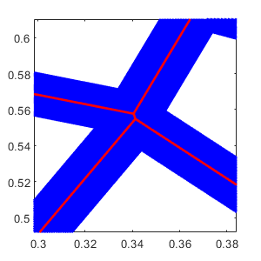
However, this is not necessarily true after shrinking when sides are removed.

Slide 47
This means some non-perimeter areas are quadrilaterals, not triangles. Therefore we need to know not just vertex angles, but which vertices are associated with each other.

Slide 48
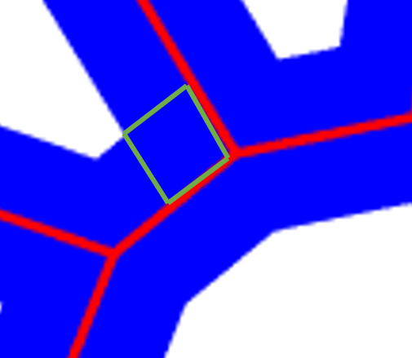
Instead of using one shape to represent each gap between perimeter rectangles, we could use multiple parallelograms to represent each gap between rectangles.
G/2
ᶿvertex
=
=

Slide 49
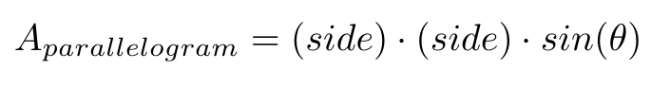
This gives the following formula, where the original perimeter based estimate is modified by adding a sum of parallelogram areas. This estimate is stored in A_unocc_est_parallelogram.
G/2
ᶿvertex
=
=

Slide 50
This can also be modified to include repeated average sized parallelograms based on average interior vertex angle. This estimate is stored in A_unocc_est_avg_parallelogram
G/2
ᶿvertex
=
=

Slide 51
This estimate still contains inaccuracy , likely occurring because when interior vertex angles are obtuse, the parallelogram formed by this vertex double-counts area already included in the perimeter estimate.

Slide 52
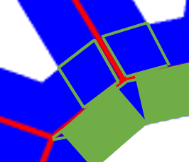
We can modify the code to form a quadrilateral (kite) with the following parameters for every obtuse vertex, in place of a parallelogram.
=
=
G/2
¹⁸⁰⁻ᶿvertex
=
ᶿvertex

Slide 53
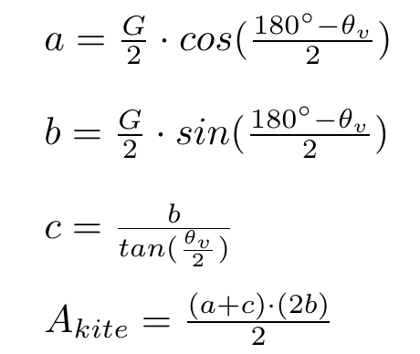
We can find the area of the kite as follows:
ᶿvertex
c
b
a
G/2
¹⁸⁰⁻ᶿvertex
This can be further used to improve the estimate and is stored in A_unocc_est_parallelograms_and_kites.

Slide 54
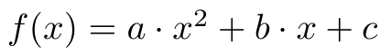
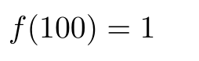
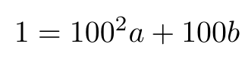
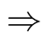
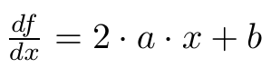
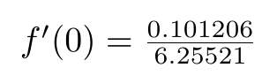


Instead of these theoretical approaches, a curve fit could also be applied to measured data to predict area occupancy. This is stored in A_unocc_est_poly_fit

Slide 55
Comparing all of these area occupancy/unoccupancy estimates shows the following results:

Slide 56
Various methods for estimating linear unoccupancy ratio are in the function fcn_MapGen_polytopesPredictUnoccupancyratio

Slide 57


To find total occupied or unoccupied length for a unit-length line, we need to know the occupied and unoccupied length per encounter and the number of encounters. We already know how to estimate number of encounters accurately from ray casting. This is the linear_density_mean quantity from the fcn_MapGen_polytopesStatistics function.
3
2
3
2
5
2

Slide 58
There are several ways to estimate linear occupancy/unoccupancy for a single encounter that we will discuss:
Using gap width as a basis for unoccupied length
Using polytope width as a basis for occupied length
Quadratic fit to measured data

Slide 59


First, we’ll discuss using gap width as a basis for measuring unoccupied length. Knowing gap width and the angle of the polytope sides, we can find the length of a specific gap.

Slide 60

Hypothesis: the average side angle for the entire field be used repeatedly to get the total unoccupied space for some length.

Slide 61
Finding all side angles for the entire obstacle field we see that the distribution is relatively even.

Slide 62

This makes sense because we would expect two polytopes shrunk from the same Voronoi line have supplementary angles.

Slide 63
The mean in this distribution was 0.5563º. Why is it not exactly 0º?

Slide 64
Asymmetry in distribution is because of trimmed polytopes at the field edges.

Slide 65


If we instead take the mean of the positive side of the distribution, is approximately 90 degrees (96.7084º in this case) meaning walls are on average, normal. Therefore, we should be able to estimate unoccupied length using gap length times the number of gaps we expect to encounter. However, this does not work as intended. This estimate is stored in L_unocc_est_gap_size_normal (assuming a 90 degree wall) and L_unocc_est_gap_size (using average of variable wall angles)

Slide 66

A different approach, would be to use the number of expected obstacle encounters and the average axis-aligned bounding box (AABB) width to estimate occupied length.
w_{i}

Slide 67
As expected, this is an over-estimate because the AABB will always be larger than any polytope that is not an axis-aligned rectangle and represents the polytope width at the worst possible traversal. This is stored in L_unocc_est_AABB_width

Slide 68

Hypothesis: as a way of avoiding the overestimate, we can use a “bounding box” extending from the 25th percentile x- and y-coordinates to the 75th percentile x- and y-coordinates.
w_{i}*
w_{i}

Slide 69
This performs better, especially at higher departure ratios. This is stored in L_unocc_est_slant_AABB_width

Slide 70

Lastly, we can do a quadratic fit like we did for area occupancy, based on the initial slope and the assumption that occupancy ranges from 0 to 1 from departure ratios of 0 to approximately 0.85 (an empirical finding). This is stored in L_unocc_est_poly_fit.

Slide 71
Ultimately, the curve fit is the most accurate at the ends of the departure ratio range, while the estimate from the modified “bounding box” performs well in the <0.53 departure ratio range.

Slide 72
Comparing these new methods to the previous method which involved taking the square root of the area occupancy ratio, we see an improvement in accuracy when using the centered 50% width and quadratic fit.

Slide 73
Theoretical Estimation of Navigation Length Cost Based on Obstacle Field Geometry
Steve Harnett

Slide 74

In the field of ground robotics, it is advantageous the know the cost of navigating through a given environment prior to committing to that mission.
https://pxhere.com/en/photo/1048296
Notes:
Use the trees we can see to assume something about trees we can’t see

Slide 75

We would like to know the relationship between navigation cost and observable obstacle field parameters so that cost can be estimated for a given obstacle field without planning the path.
$
http://images.clipartpanda.com/map-clipart-folded-map.png

Slide 76

Obstacles in the field can be represented by impassable convex polytopes. These polytopes may be nearly fully tiled, forcing the planning algorithm to route around the perimeters of the obstacles, or spaced apart by larger gaps, giving the planning algorithm more freedom to operate within.
Notes:
Maps, as far as this work is concerned, will refer to a binary map detailing only obstacles and free space.

Slide 77

Polytopes are chosen as an obstacle representation because they are a grid-free, memory-efficient representation, requiring that only their vertices are stored. Additionally, when convex, the planner will not get “stuck” in obstacle local minima while trying to minimize distance to the goal. Concave obstacles can be bounded by convex polygons to represent them in this manner.
Tau, S.A. (2021) The Effects of Path-Planning Uncertainty on Intelligent Vehicle Performance [PhD Disertation] The Pennsylvania State University

Slide 78

Individual obstacles can be described by their maximum radius, R, where radii are defined as distance from centroid to vertices. Standard deviation of obstacle radius, σ_{R}, obstacle density, ρ, and occupancy ratio, r_{A,occ}, can be used to characterize the obstacle field holistically.
Tau, S.A. (2021) The Effects of Path-Planning Uncertainty on Intelligent Vehicle Performance [PhD Disertation] The Pennsylvania State University

Slide 79
Individual obstacles can be described by their maximum radius, R, where radii are defined as distance from centroid to vertices. Standard deviation of obstacle radius, σ_{R}, obstacle density, ρ, and occupancy ratio, r_{A,occ}, can be used to characterize the obstacle field holistically.
Tau, S.A. (2021) The Effects of Path-Planning Uncertainty on Intelligent Vehicle Performance [PhD Disertation] The Pennsylvania State University

Slide 80





To describe the complexity of an obstacle field, we can use departure ratio, r_{D} , which is the product of average max radius of all polytopes in the field and the square root of area point density.
Tau, S.A. (2021) The Effects of Path-Planning Uncertainty on Intelligent Vehicle Performance [PhD Disertation] The Pennsylvania State University
Notes:
This is a dimensionless parameter and values of this parameter can be observed in fields with different parameters. For example, as shown in figure /handle, two fields with 20 obstacles per unit area each can have very different departure ratios based on obstacle size, however a field with over double the number of obstacles an have a similar departure ratio, if it also has a smaller average obstacle size.

Slide 81
To describe the complexity of an obstacle field, we can use departure ratio, r_{D} , which is the product of average max radius of all polytopes in the field and the square root of area point density.
Tau, S.A. (2021) The Effects of Path-Planning Uncertainty on Intelligent Vehicle Performance [PhD Disertation] The Pennsylvania State University
Notes:
This is a dimensionless parameter and values of this parameter can be observed in fields with different parameters. For example, as shown in figure /handle, two fields with 20 obstacles per unit area each can have very different departure ratios based on obstacle size, however a field with over double the number of obstacles an have a similar departure ratio, if it also has a smaller average obstacle size.

Slide 82

To describe the cost of a path, we can use the ratio of the total path length required to navigate around obstacles, L_{P}, over the Euclidean distance from the start to the goal, L_{E}, which we call the length cost ratio, r_{LC}.
Tau, S.A. (2021) The Effects of Path-Planning Uncertainty on Intelligent Vehicle Performance [PhD Disertation] The Pennsylvania State University

Slide 83

Previously an empirical relationship between length cost ratio and departure ratio was discovered.
This was obtained by running path planning simulations for each data point over obstacle field maps and measuring the length cost of the navigated paths.
Tau, S.A. (2021) The Effects of Path-Planning Uncertainty on Intelligent Vehicle Performance [PhD Disertation] The Pennsylvania State University
Notes:
Fix figure axis labels to be legible at this resolution

Slide 84
This work aims to discover a relationship between obstacle field parameters and length cost without requiring repeated runs of path planning algorithms in simulation.
Upper bound
Average case
Notes:
Fix figure axis labels to be legible at this resolution

Slide 85
To achieve this, we will model path planning as a repeated series of single obstacle encounters. Therefore, estimating the cost consists of two separate formulae: one to estimate the average divergence necessary to route around the average obstacle geometry and one to estimate the number of encountered obstacles in a path of a given length.
2
3
1
Notes:
The entire navigation task can be decomposed into the discrete subtasks of routing around each blocking obstacle. Based on this, the entire length cost of navigating through the obstacle field is equal to the sum of the length cost of navigating around each obstructing obstacle. From this, it can be assumed that the total length cost of navigating through the entire obstacle field can be approximated by the length cost of navigating around an obstacle with average geometry multiplied by the expect number of obstructing obstacles.

Slide 86




The first step is to determine what this average polytope geometry is for the desired path.
?
+
+
1
2
3
=
Avg.
3

Slide 87

One way to conceptualize this, is that a path planner is like PID control, having a concept of how the current decision relates to future decisions (derivative) and past decisions (integral). Modelling this with repeated individual obstacle encounters is analogous to trying to get similar performance from proportional control only, reacting only to the obstacle in front of the vehicle.
https://en.wikipedia.org/wiki/PID_controller#/media/File:PID_en.svg

Slide 88
One way to conceptualize this, is that a path planner is like PID control, having a concept of how the current decision relates to future decisions (predictive) and past decisions (memory). Modelling this with repeated individual obstacle encounters is analogous to trying to get similar performance from proportional control only, reacting only to the obstacle in front of the vehicle.
https://en.wikipedia.org/wiki/PID_controller#/media/File:PID_en.svg

Slide 89
To determine the relevant choices, first we disregard any angles whose vertex normal do not point in the direction of travel.
Travel direction
Notes:
Travel direction is accounted for rather than considering all angles as obstacle fields could conceivable have different average geometries for different travel directions. A physical example to illustrate this would be a desert of barchan sand dunes, which form a sawtooth wave pattern based on wind direction, resulting in a field that has very steep obstacles in one travel direction, but shallower obstacles in the opposite direction.

Slide 90
We also disregard vertices whose vertex normal is not within half the vertex size, θ_{vertex}, as this implies that, while the vertex is facing away, the polytope is not obstructing the path.
Travel direction
Vertex-width search
cone
=
=
ᶿvertex
Interior
vertex
normal

Slide 91
For each encounter with a polytope obstructing the path, we can model navigating around the obstacle as a choice between the larger and smaller divergence angles, θ_{big} and θ_{small} , respectively.
Travel direction
ᶿbig
ᶿsmall
Notes:
Each vertex is assumed to be a potential decision point, where a path planning algorithm could have to make a choice between the larger and smaller divergence angle, diverting the path from the straight line Euclidean distance from start to goal.

Slide 92
Knowing the divergence angle and associated side length gives a length cost ratio for this individual encounter.
Lbig
Sbig
Travel direction
ᶿbig
ᶿsmall
Ssmall
Lsmall
This will indicate the distance the vehicle has to traverse, defined by S_{big} and S_{small} , the side lengths associated with the bigger and smaller deflection angles, respectively, and the distance the vehicle will progress towards the goal, defined by L_{big} and L_{small} , the distances moved forward according to the travel direction, resulting from navigating around the bigger and smaller divergence, respectively.
Notes:
Do we need a citation here for bug or similar planners?

Slide 93

For each angle we can use the direction of travel to find the chosen, smaller divergence angle and unchosen, larger divergence angle, and their associated side lengths. We can do this with path vector, vertex normal vector, and vertex magnitude.
Interior
vertex
normal
ᶿbig
ᶿvertex
Travel direction
ᶿVN,TD
ᶿsmall

Slide 94
Pseudo-code for this process is as follows:
for each polytope:
for each vertex in polytope:
// ensure polytope is blocking travel direction
if vertex opens away from travel direction
&&
vertex normal is less than half the vertex angle from travel direction:
// determine which direction is the smaller divergence
cross the interior vertex normal with the travel direction
note the larger divergence angle and its side length
note the smaller divergence angle and its side length

Slide 95

Once each polytope has been analyzed, we have a set of the chosen divergence angle and associated side length for every decision that a planner could have to make in this field, for this travel direction. From this we can determine the average deflection associated with the “good decisions” around our statistical average obstacle.
Notes:
Remove red distribution

Slide 96

Now that the average obstacle geometry is known, we have to determine the number of expected encounters, N_{int}.
2
3
1
$$≈$$
.
3
Avg.
}
N_{int}

Slide 97
As mentioned before when defining departure ratio, encounter rate will depend on both obstacle point density and obstacle size.
Notes:
Encounter rate will increase with both increasing obstacle size and increasing obstacle point density.

Slide 98




We can use the square root of area point density,ρ ,as an approximation of linear point density density, λ, over the course of a path of length L, but this only works well for uniform, nearly-fully tiled obstacle fields.
2
3
1
Notes:
This work describes three approaches for estimating the number of encountered obstacles.

Slide 99

As obstacles in the field shrink, despite the area point density not changing, a straight line is less likely to encounter obstacles because the occupied space has decreased.
2
3
1
2
1

Slide 100




This leads us to a method that can account for obstacle size, so an approximation can be derived in terms of linear unoccupancy ratio, r_{L,unocc}, distance from start to goal, L, and average gap size $\overline{G}$.
G_{i}
Tau, S.A. (2021) The Effects of Path-Planning Uncertainty on Intelligent Vehicle Performance [PhD Disertation] The Pennsylvania State University
Notes:
Graphical definition of gap size

Slide 101



As obstacles get smaller, the path is less likely to intersect them, so an approximation can be derived in terms of occupancy ratio.
Tau, S.A. (2021) The Effects of Path-Planning Uncertainty on Intelligent Vehicle Performance [PhD Disertation] The Pennsylvania State University

Slide 102


This method accounts for point density but not obstacle size. As obstacles get smaller, the path is less likely to intersect them, so an approximation can be derived in terms of length unoccupancy ratio, r_{L,unocc},
Tau, S.A. (2021) The Effects of Path-Planning Uncertainty on Intelligent Vehicle Performance [PhD Disertation] The Pennsylvania State University

Slide 103
A third method, is to employ ray casting to estimate linear point density by measuring how many polytopes are intersected by randomly casted rays, normalizing this by ray length, and averaging this over the entire field. As obstacles shrink, we expect this value to decrease.
3
2
3
2
5
2

Slide 104

Plotting all three of these concurrently shows that the estimate from occupancy ratio grows exponentially for high departure ratios, which is expected as gap size approaches zero. The estimate based on lienar point density is constant, as expected for obstacle fields of the same area point density. The estimate from ray casting is near zero for departure ratios of zero, as expected because obstacles are nearly completely shrunk at this point.

Slide 105
Now that the average obstacle geometry and the estimated number of encounters, N_{int} is known, we can predict the length cost required to route around N_{int} average-sized obstacles.
+
+
3
2
Avg.
1
N_{int}
=
}
3

Slide 106
The estimated number of encountered obstacles, N_{int}, informs the predicted spacing of obstacles along the path while the estimate for deflection per obstacle, R_{c} , informs the predicted deflection perpendicular to the path. These two quantities together give an estimate for total path length.
L_{E} /N_{int}
R_{small}
2
1
Notes:
Ditch red outlines

Slide 107


The estimated number of encountered obstacles, N_{int}, informs the predicted spacing of obstacles along the path while the estimate for deflection per obstacle, R_{c} , informs the predicted deflection perpendicular to the path. These two quantities together give an estimate for total path length.
Interior
vertex
normal
ᶿbig
ᶿvertex
Travel direction
ᶿVN,TD
ᶿsmall
Ssmall
R_{small}

Slide 108

To test this, simulated obstacle fields are created by forming a Voronoi diagram about points from the Halton set, then shrinking the convex polytopes inward from the Voronoi boundaries to the desired radii. Maps were generated with 100 obstacles in a 1-kilometer-by-1-kilometer square area, obstacle radii between 1 and 81 meters, and standard deviation of obstacle radii between 0 and 0.32. The cost estimation algorithm was then evaluated on these maps and compared to the cost from measuring the performance of a path planning algorithm over maps with the same parameters.
Tau, S.A. (2021) The Effects of Path-Planning Uncertainty on Intelligent Vehicle Performance [PhD Disertation] The Pennsylvania State University

Slide 109

Plotting predicted costs over simulated cost data shows that the cost with the estimated obstacle count from occupancy ratio follows the higher standard deviation trends from path planning, forming an upper bound worst case, while the cost with actual obstacle count from ray casts follows the trends of the mean of the gamma distribution fit to the path planning data.

Slide 110

Plotting predicted costs over simulated cost data shows that the cost with the estimated obstacle count from occupancy ratio follows the higher standard deviation trends from path planning, forming an upper bound worst case, while the cost with actual obstacle count from ray casts follows the trends of the mean of the gamma distribution fit to the path planning data.

Slide 111

For a 4000-obstacle field, time profiling shows 29.405s wall time for entire call stack, with 0.701s self-time spent in the prediction algorithm code.

Slide 112

Path planning with bounded A* through an obstacle field of the same point density, average radius, and radius standard deviation takes 203.77s wall time, with 22.889s self-time spent in bounded A*. This means the prediction code is ~7x faster by wall time, and the algorithm is ~32.7x faster than bounded A* by self-time. Additionally, there are approximately 100x as many points in the empirical scatter as were used in the theoretical curves, so accounting for that gives an improvement of ~700x by wall time and ~3200x by self-time.
Notes:
Perhaps put this in a table.

Slide 113

One caveat is that choosing the smaller angle does not necessarily lead to the shortest path. This is because the divergence angle selection algorithm cannot look ahead like the path planning algorithm to see when a larger divergence from the Euclidean distance would yield a shorter path, it always selects the smallest divergence from the Euclidean distance, even when this yields a poor scenario later.

Slide 114
Another potential issue with this cost estimation algorithm is that it assumes there is no cumulative error in the direction normal to the travel direction caused by modeling path planning as always choosing to route around obstacles on the sides with small divergence angles. In other words, there is an assumption that if the vehicle always routes around the small side of an obstacle, this is not always a turn to one side. The obstacle fields used in testing this algorithm started as fully tessellated maps of polytopes. Thus, always choosing a small divergence angle is as likely to lead a right turn as it is to be a left turn since one obstacle having its small divergence angle on the right side of the travel direction, implies the geometry of the adjacent obstacle would have its small divergence angle on the left side of the travel direction. If an obstacle field was generated from a method that does not start from a fully tiled field, it is possible that the planner model would accumulate a lateral error while routing towards the goal longitudinally in the travel direction.
ᶿsmall
ᶿsmall
Travel direction
Travel direction

Slide 115

Conclusions
From looking at map geometry, without any path planning simulation, cost of navigating through the obstacle field can be estimated, both in the most likely case and in a theoretical worst case.
This algorithm can get data for a specific map, not just a geometrically similar map.
Additionally, because this is done without the planner in the loop, this can be obtained without a designed and implemented path planner.

Slide 116
Future Work
One edge case this algorithm is susceptible to is selecting sub-optimal paths when large divergence leads to a shorter overall path length. Mitigations for this could be developed so the heuristic’s decisions more closely resemble the decisions of a path planner.
Using the square root of area density as an estimate for the encountered obstacle rate is inaccurate and could be improved by exploring relationship between obstacle radius standard deviation and linear point density.
Analysis of real maps could be performed and compared to the results of geometric, simulated maps.

Slide 117
Outline
Introduction and Motivation
Prior Work
Introduction to straight path planner
Straight path cost prediction
Encounter rate prediction
Occupancy prediction
Results
Compared to straight path planner
Compared to around path planner and prediction

Slide 118
Outline
Introduction and Motivation
Prior Work
Introduction to straight path planner
Straight path cost prediction
Encounter rate prediction
Occupancy prediction
Results
Compared to straight path planner
Compared to around path planner and prediction

Slide 119
In the field of ground robotics, it is advantageous the know the cost of navigating through a given environment prior to committing to that mission.
https://pxhere.com/en/photo/1048296
Notes:
Use the trees we can see to assume something about trees we can’t see

Slide 120
We would like to know the relationship between navigation cost and observable obstacle field parameters so that cost can be estimated for a given obstacle field without planning the path.
$
http://images.clipartpanda.com/map-clipart-folded-map.png

Slide 121
Outline
Introduction and Motivation
Prior Work
Introduction to straight path planner
Straight path cost prediction
Encounter rate prediction
Occupancy prediction
Results
Compared to straight path planner
Compared to around path planner and prediction

Slide 122

Previously, we showed that we can estimate the cost of going around obstacles.

Slide 123
This was accomplished by modelling planning as repeated individual obstacle encounters with an average sized obstacle.
2
3
1
$$≈$$
.
3
Avg.
}
N_{int}

Slide 124
Outline
Introduction and Motivation
Prior Work
Introduction to straight path planner
Straight path cost prediction
Encounter rate prediction
Occupancy prediction
Results
Compared to straight path planner
Compared to around path planner and prediction

Slide 125

If obstacles are traversable at some constant cost, rather than impassable, we want to know if it is possible to avoid the planning task by choosing to route through all obstacles. To know if routing through is optimal, we have to be able to estimate this straight path cost.

Slide 126
Every departure ratio should have some traversal cost, below which, routing through the entire field is optimal and path planning is unnecessary.

Slide 127
Outline
Introduction and Motivation
Prior Work
Introduction to straight path planner
Straight path cost prediction
Encounter rate prediction
Occupancy prediction
Results
Compared to straight path planner
Compared to around path planner and prediction

Slide 128

The first step to predicting straight path cost is understanding that obstacle field properties, such as obstacle size and density, affect what portion of the path is occupied and therefore what portion of the path has more difficult traversal.

Slide 129
Therefore, the key component to the cost estimate is estimating linear occupancy ratio or the portion of the straight path that requires traversal, if the traversal cost is uniform and known.

Slide 130
Outline
Introduction and Motivation
Prior Work
Introduction to straight path planner
Straight path cost prediction
Encounter rate prediction
Occupancy prediction
Results
Compared to straight path planner
Compared to around path planner and prediction

Slide 131
To find total occupied or unoccupied length for a unit-length line, we need to know the occupied and unoccupied length per encounter and the number of encounters. We already know how to estimate number of encounters accurately from ray casting.
3
2
3
2
5
2

Slide 132
Outline
Introduction and Motivation
Prior Work
Introduction to straight path planner
Straight path cost prediction
Encounter rate prediction
Occupancy prediction
Results
Compared to straight path planner
Compared to around path planner and prediction

Slide 133
There are several ways to estimate linear occupancy/unoccupancy for a single encounter that we will discuss:
Using gap width as a basis for unoccupied length
Using polytope width as a basis for occupied length
Quadratic fit to measured data

Slide 134
There are several ways to estimate linear occupancy/unoccupancy for a single encounter that we will discuss:
Using polytope width as a basis for occupied length
Quadratic fit to measured data

Slide 135
First, we’ll discuss using gap width as a basis for measuring unoccupied length. Knowing gap width and the angle of the polytope sides, we can find the length of a specific gap.

Slide 136
Hypothesis: the average side angle for the entire field be used repeatedly to get the total unoccupied space for some length.

Slide 137
Finding all side angles for the entire obstacle field we see that the distribution is relatively even.

Slide 138
This makes sense because we would expect two polytopes shrunk from the same Voronoi line have supplementary angles.

Slide 139
The mean in this distribution was 0.5563º. Why is it not exactly 0º?

Slide 140
Asymmetry in distribution is because of trimmed polytopes at the field edges.

Slide 141
If we instead take the mean of the positive side of the distribution, is approximately 90 degrees (96.7084º in this case) meaning walls are on average, normal. Therefore, we should be able to estimate unoccupied length using gap length times the number of gaps we expect to encounter. However, this does not work as intended.

Slide 142
A different approach, would be to use the number of expected obstacle encounters and the average axis-aligned bounding box (AABB) width to estimate occupied length.
w_{i}

Slide 143
As expected, this is an over-estimate because the AABB will always be larger than any polytope that is not an axis-aligned rectangle and represents the polytope width at the worst possible traversal.

Slide 144
Hypothesis: as a way of avoiding the overestimate, we can use a “bounding box” extending from the 25th percentile x- and y-coordinates to the 75th percentile x- and y-coordinates.
w_{i}*
w_{i}

Slide 145
This performs better, especially at higher departure ratios.

Slide 146
Lastly, we can do a quadratic fit like we did for area occupancy, based on the initial slope and the assumption that occupancy ranges from 0 to 1 from departure ratios of 0 to approximately 0.85 (an empirical finding).

Slide 147
Ultimately, the curve fit is the most accurate at the ends of the departure ratio range, while the estimate from the modified “bounding box” performs well in the <0.53 departure ratio range.

Slide 148
Comparing these new methods to the previous method which involved taking the square root of the area occupancy ratio, we see an improvement in accuracy when using the centered 50% width and quadratic fit.

Slide 149
Outline
Introduction and Motivation
Prior Work
Introduction to straight path planner
Straight path cost prediction
Encounter rate prediction
Occupancy prediction
Results
Compared to straight path planner
Compared to around path planner and prediction

Slide 150
Integrating these linear occupancy estimates into the straight path cost predictor enables a more accurate estimate of the cost of driving straight across the field, compared to prior estimates we had available.

Slide 151

Integrating the centered bounding box linear occupancy estimate into the straight path cost predictor enables a conservative estimate of the cost of driving straight across the field.

Slide 152
And we can further improve this estimate by switching which linear unoccupancy estimate we use based on which we expect to be closer.

Slide 153
Outline
Introduction and Motivation
Prior Work
Introduction to straight path planner
Straight path cost prediction
Encounter rate prediction
Occupancy prediction
Results
Compared to straight path planner
Compared to around path planner and prediction

Slide 154
We can then overlay this on the data and prediction for the cost of routing around to compare.

Slide 155
The utility of this is identifying the departure ratio, for a given cost, above which you should route straight through the field.

Slide 156
For example, we can see that above r_{D}~0.5, with a polytope traversal cost of 1.167, routing through is predicted to produce a lower cost than the worst case of routing around.

Slide 157
But for a higher polytope traversal cost, such as 1.333, routing through is not better than the upper bound of routing around until r_{D}~0.65.

Slide 158
Another interesting yield from this, which we speculated about earlier, is that routing straight through seems to quickly become worse than the typical estimate for the cost of routing around, requiring a polytope traversal cost of only about 116.7% of the freespace traversal cost.

Slide 159

We can also show a scatter of predicted data versus

Slide 160
Trends are slightly easier to see if predicted data is plotted as a poly fit instead of a scatter.

Slide 161
Then we can look at this compared to the cost of routing around obstacles and see for each traversal cost and departure ratio, whether routing around or routing through is optimal.

Slide 162
Looking at just the predicted cost curves gives us a lookup chart for these crossover points.

Slide 163
Detailed view of the behavior at low departure ratios.

Slide 164
One interesting yield from this, which we speculated about earlier, is that routing straight through seems to quickly become worse than the typical estimate for the cost of routing around, requiring a polytope traversal cost of only about 115.7% of the freespace traversal cost.

Slide 165

If polytopes are modelled as roughly circular, a good assumption for the Halton set, The length cost ratio for a single obstacle can be approximated as a constant.
L_{P}
L_{E} = D

Slide 166
This is a poor case because in practice, given larger gaps between obstacles, the planner can go around more efficiently than routing tightly to the perimeter.
Small or no gap
Wider gap
L_{P}
L_{P}
L_{E} = D
L_{E}

Slide 167
This is a potential reason why the half-pi traversal cost data follows the upper boundary of the densest cluster of data from the routing around set.

Slide 168

Time profiling shows that predicting the straight path cost is significantly faster than finding the exact value from a path planner which requires determining intersections of line segments.

Slide 169
Limitations
Assumes uniform cost
Assumes Halton set (uniform obstacle size and spatial distribution)

Slide 170
Next steps
Non-uniform obstacle cost
Non-uniform obstacle size and spatial distribution
Using this process on subsets of the map to make the decision of through or around at different locations instead of once for the whole map

Slide 171
Upcoming Tasks
Next week:
Prepare to merge and publish this work (documentation, figures, etc.)
Further ahead:
Lay out design for vgraph improvements/refactor.
Rviz profile needs to be able to visualize planned paths.
Asymmetric obstacle fields.

